Slide 1
RECAP
OBJECTIVE
01
02
03
To identify the pattern of most frequent crimes and their distribution across neighborhoods in Los Angeles to detect high-crime areas.
To model a predictive model of crime occurrences, enabling a proactive approach for resource allocation
To evaluate potential for predictive modeling in forecasting crimes on historical patterns and influencing factors.

Slide 2
CRISP-DM

Slide 3

Business Understanding
Modeling
Goal: Predict crimes and identify hotspots to aid resource allocation.
-Clustering: K-Means for hotspots.
-Classification: Random Forest, XGBoost, Decision Tree.
-Forecasting: Holt-Winters for future trends.
Data Preparation
Data Understanding
Deployment
Evaluation
-Cleaned: Fixed missing values, standardized formats.
-Engineered: Time-of-day, day-of-week categories.
-Removed Outliers: Applied IQR method
-Source: LAPD crime data (2020-present).
-Key Insights:
–Top crime: Vehicle theft.
–Hotspots: Central LA, 77th Street.
–Peak time: 11 AM - 12 PM.
-Tools: Saved models, dashboards for real-time insights.
-Outcome: Improved resource allocation and crime prevention.
-Metrics: Accuracy, F1-score, MAE, RMSE.
-Result: Reliable theft predictions and crime insights.

Slide 4
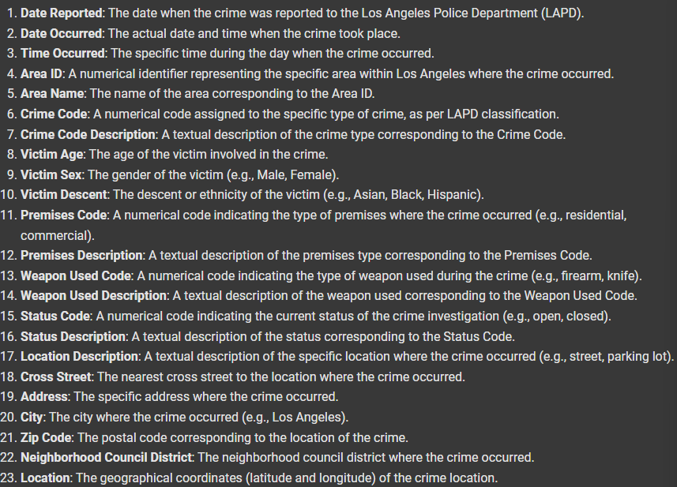
DATA DESCRIPTION
Notes:
The data consists of 23 features as shown below.

Slide 5
Data Preprocessing

Slide 6
Data Pre-processing
Data Collection
Data Selection
Data Formatting
Clean Data
Construct Data
Focused on key columns: Crime type, date/time, location, and victim details.
LAPD crime dataset (2020-present) retrieved for analysis.
- Standardized date and time formats.
- Derived time-of-day and date components.
- Addressed missing values (e.g., premises descriptions).
- Removed outliers using IQR.
Created new features like time periods (e.g., morning, evening) and crime categories.

Slide 7
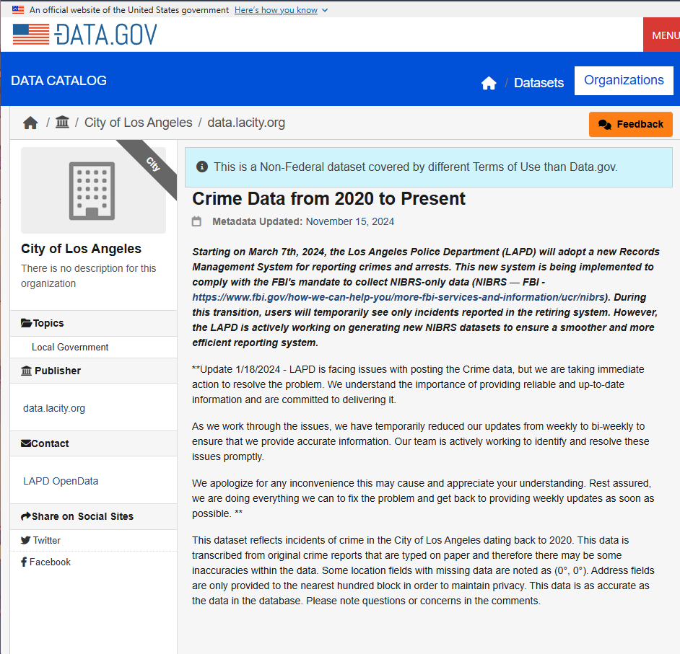
RECAP
DATA COLLECTION
Source:
https://catalog.data.gov/dataset/crime-data-from-2020-to-present
Size of Data | Contain 112052 Rows, and 23 Column
Range | Reported Crime Incidents in Los Angeles from 2020 to 2024
Features Data Type | Integer: ['TIME OCC', 'AREA', 'Rpt Dist No', 'Part 1-2', 'Crm Cd', 'Vict Age'] Float: ['Premis Cd', 'Weapon Used Cd', 'Crm Cd 1', 'Crm Cd 2', 'Crm Cd 3', 'Crm Cd 4', 'LAT', 'LON'] String: ['Date Rptd', 'DATE OCC', 'AREA NAME', 'Crm Cd Desc', 'Mocodes', 'Vict Sex', 'Vict Descent', 'Premis Desc’, 'Weapon Desc', 'Status', 'Status Desc', 'LOCATION', 'Cross Street'.
Notes:
Data was collected from the U.S Government Open Data, dataset labelled Crime Data from 2020 to present. It is a dataset from the Los Angeles Police Department (LAPD), this dataset reflects the incidents of crime in the city of Los Angeles dating back to 2020.

Slide 8
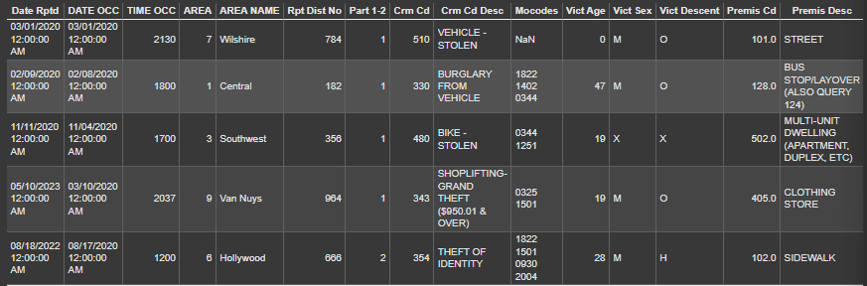
Data Selection
Only Certain Column that is selected (Highlighted) . Other column are drop
Notes:
The first step is data selection. It concerns with the data that we use for our analysis as well as attributes and records for the table. The criteria for selection of data can depend on the data mining goals, quality of data, technical constraints and so on. Initially we select the appropriate columns that are aligned with our objectives of assessing patterns of the most frequent crime type and predicting crime occurrences based on date and time. Only certain columns that are related will be selected for our analysis as highlighted in the diagram shown. The other non-related columns are dropped.
Select appropriate column based on the objective to predict crime occurrences based on Date & Time

Slide 9
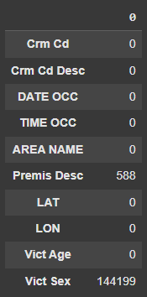
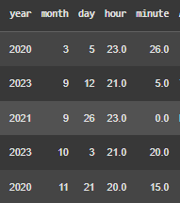
Data Cleaning
Missing values
Date False Formating
Standardizing format into year, month, day
for data consistency
Notes:
The main goal of data cleaning is to increase the quality of the data used for analysis.
To handle incomplete data which are the missing values:
We can either perform selection of cleaner subset of the overall data,
Deletion of rows with missing data if comprise only a small portion,
Imputation of missing values with the most suitable defaults.
An example of our case will be cross checking with LONGITUDE AND LATITUDE DATA to fill in the null values of the premises description column
To handle false formatting issues
We perform standardisation of the date formats into year, month, day columns as shown in the diagram for data consistency
To handle outliers
We can identify and address outliers in the data set that could potentially cause skewness of results using the formula shown:
Outliers identified and removed if observation data does not fall within upper and lower boundary.
This Include handling missing values, handling false formatting and handling outliers
IQR (Interquartile range) =
Q3 (Third quartile) - Q1 (First Quartile)
Upper boundary = Q3 + 1.5 IQR
Lower boundary = Q1 - 1.5 IQR

Slide 10
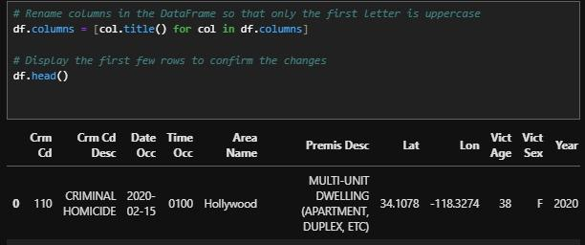
Data Cleaning
Column Renaming
Handling Outliers
Identification of Outliers :
IQR = Q3 - Q1
Upper boundary = Q3 + 1.5 IQR
Lower boundary = Q1 - 1.5 IQR
Outliers identified and removed if observation data does not fall within upper and lower boundary.
Standardized column naming so that only 1st letter is uppercase
Notes:
The main goal of data cleaning is to increase the quality of the data used for analysis.
To handle incomplete data which are the missing values:
We can either perform selection of cleaner subset of the overall data,
Deletion of rows with missing data if comprise only a small portion,
Imputation of missing values with the most suitable defaults.
An example of our case will be cross checking with LONGITUDE AND LATITUDE DATA to fill in the null values of the premises description column
To handle false formatting issues
We perform standardisation of the date formats into year, month, day columns as shown in the diagram for data consistency
To handle outliers
We can identify and address outliers in the data set that could potentially cause skewness of results using the formula shown:
Outliers identified and removed if observation data does not fall within upper and lower boundary.
This Include handling missing values, handling false formatting and handling outliers
IQR (Interquartile range) =
Q3 (Third quartile) - Q1 (First Quartile)
Upper boundary = Q3 + 1.5 IQR
Lower boundary = Q1 - 1.5 IQR

Slide 11
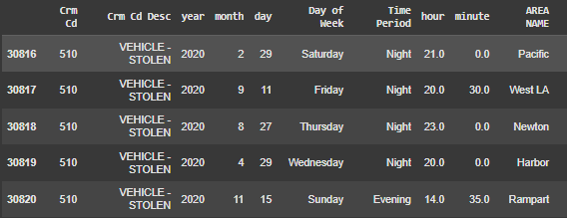
Construct Data
1.Raw timestamps into time-of-day groups: Early Morning, Morning, Noon, Evening and Night.
Categorisation
2.Raw date data into days-of-the-week groups such as Monday, Tuesday and so on.
Notes:
Construction of data involves production of derived attributes, new records or transformed values from existing attributes.
In our case we perform categorisation of the distinct variables within certain columns into broader categories for ease of analysis and processing
For example, raw timestamps grouped into time-of-day groups such as Early Morning, Morning, Noon, Evening and Night.
Eg. Time 2100 falls under Night category whereas 1700 falls under Evening category
Categorisation of raw date data into days-of-the-week groups such as Monday, Tuesday, Wednesday and so on.
Categorisation of crime types into broader groups such as various vehicle-related crimes (Motor vehicles, boat, bike etc) under “Vehicle Theft - Attempt” and “Vehicle Theft - Stolen” groupings.

Slide 12
Exploratory Data Analysis
Notes:
"Good [morning/afternoon], everyone. In this presentation, we’ll walk through the key findings from the exploratory data analysis conducted for our crime prediction project. Our objective is to gain actionable insights from the data to build effective predictive models."

Slide 13
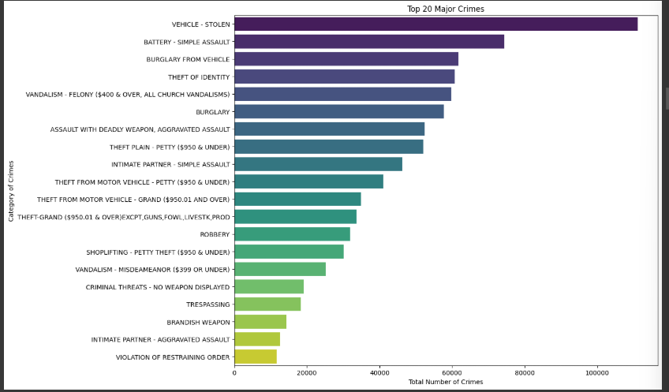
Data Exploration 1 : Types of Crime Committed
Data Insights :
-There are many types of crime with Vehicle theft crime is the highest number recorded.
Notes:
In the first chart, we see the top 20 crime categories. The most reported crimes include 'Vehicle Theft,' 'Battery - Simple Assault,' and 'Burglary from Vehicle.' This insight helps us understand where law enforcement resources are most needed and provides context for prioritizing predictive models.

Slide 14
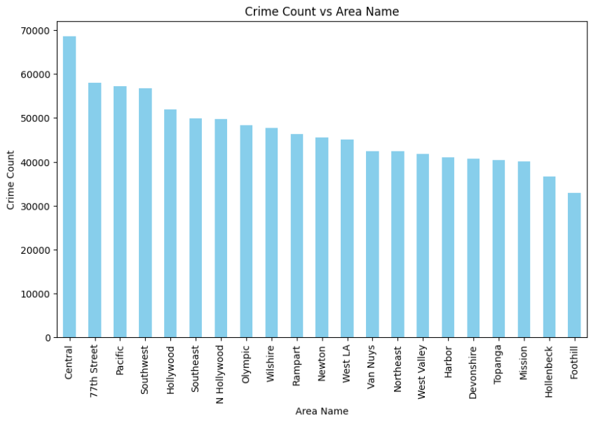
Data Exploration 2 : Behaviour of variable stated in the objective - Crime Area
Data Insights :
- When comparing the crime count vs area in Los Angeles, Central Los Angeles has the highest crime count, followed by 77th Street and the Pacific region
Notes:
Next highlights crime counts by area. Central and 77th Street lead in reported incidents, making them critical areas for intervention strategies. This information can help allocate patrol units and community outreach more effectively.

Slide 15
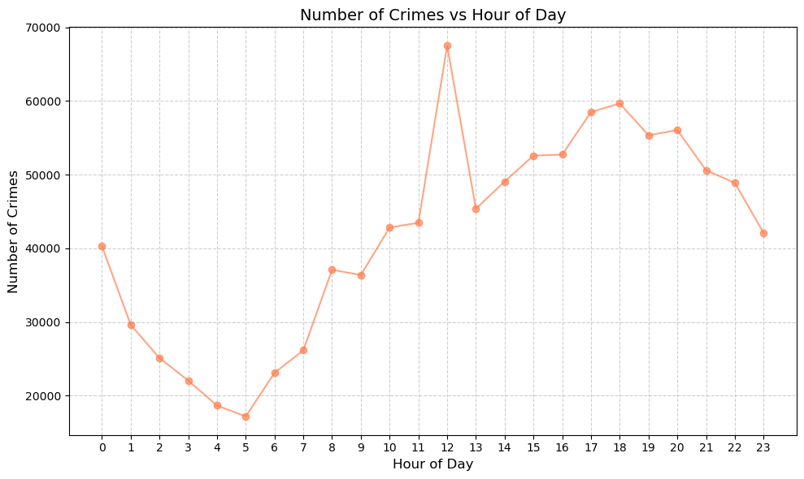
Data Exploration : Time of Crime Occurrence
Data Insights :
- The crime count recording increasing throughout the day
Notes:
The third visualization shows crime counts throughout the day. Interestingly, there is a sharp spike at noon and another peak between 6 PM and 9 PM. These findings suggest that predictive models should incorporate temporal features, as time of day significantly impacts crime patterns.

Slide 16
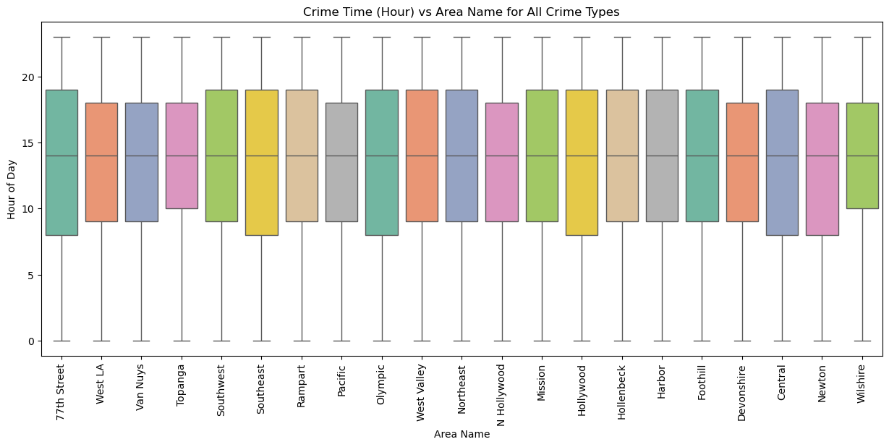
Data Exploration : Time of Crime Occurrence
Data Insights :
- Median time of crime occurrence is 1500 hr.
- This indicate a wrong data formatting that leads to this visualization.
Notes:
Crime Comparison Across Areas: The boxplot shows consistent crime timing across all areas, with similar medians and distributions.
No Outliers: There are no significant outliers in the data, ensuring clean and reliable insights.
Crime Time Distribution:
Most crimes occur between the morning and late evening, as indicated by the range of the box (interquartile range, or IQR) in the middle section.
The median crime time for most areas is in the late afternoon to evening hours (around 14:00
Comparison Across Areas:
The overall pattern of crime timing is fairly consistent across the different areas, with slight variations in medians and spread.
Some areas, like "77th Street," show a slightly earlier median crime time compared to others.
Outliers and Extremes:
The whiskers extend from early morning (0:00) to late at night (23:00), indicating crimes happen at all times of the day, though less frequently during these extremes.
There are no significant outliers beyond the whisker range in this plot.
Homogeneity:
The similarity in the distributions suggests a general trend of crime patterns that is not heavily skewed for any specific area.
This plot would be helpful for stakeholders like law

Slide 17
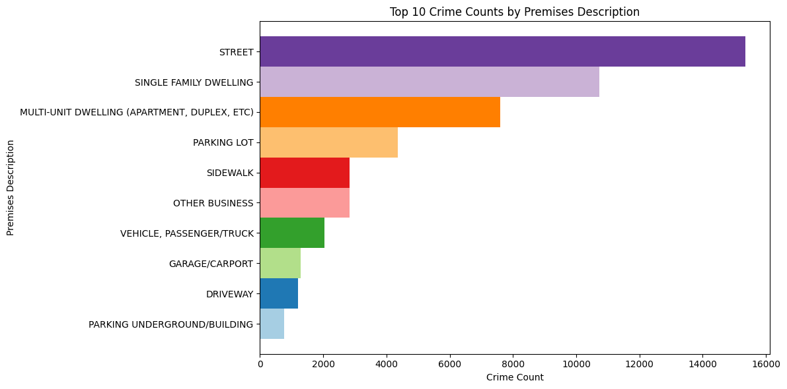
Data Exploration : Behaviour of variable stated in the objective - Crime Area
Data Insights :
-When we go deeper into the location, it’s found that the most crime happened in the street followed by single family dwellings.
Notes:
"This bar chart represents the top 10 crime categories based on premises descriptions. We observe that most crimes occur on the street, followed by single-family dwellings and multi-unit dwellings like apartments and duplexes. This insight suggests that areas with high pedestrian traffic and residential zones are key hotspots for criminal activity. Such patterns will guide our predictive modeling and resource allocation strategies."

Slide 18
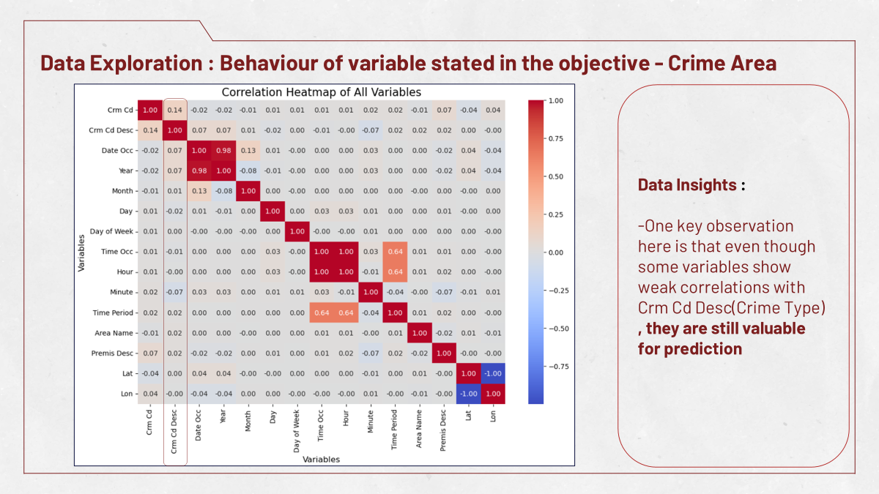

Slide 19
Modeling
Notes:
Hi, I am Nicholas, I will be presenting on the modeling section.

Slide 20


Understand the Modeling Goals
To predict types of crimes occurrence
To Forecast future Crime Rate
Use classification models to predict type of crime occurrence based on historical data (Date & Time)
Use Time-Series Forecasting to predict future crimes (based on location, time, and type) and uncover hotspots.
Notes:
For our modeling goals, we aimed to predict the types of crimes occured with classification model and time-series forecasting to forecast future crime

Slide 21
Model Training Process
Feature Engineering
Splitting the Dataset
Hyperparameter Tuning
Label Encoding converts categorical data into numerical values by assigning a unique number to each category.
Log Transformation: reduce large values in data by applying a logarithm.
Divide data into:
Training Set (80%): For teaching the model patterns.
Testing Set (20%): For evaluating model performance on unseen data.
Use Grid Search or Random Search to optimize parameters like tree depth (Random Forest) or learning rate (Gradient Boosting).
Notes:
This is the process that we carried out. Firstly, we did feature engineering, mainly focusing on label encoding and log transformation. Then we split the data for training and testing, before doing hyperparameter tuning to improve model performance. We will go into details each step in the coming slides.

Slide 22

Model Training Process
Feature Engineering
Label Encoding converts categorical data into numerical values by assigning a unique number to each category.
Log Transformation: reduce
large values in data by applying
a logarithm.
Log (x+1)
Before
After
Notes:
Firstly, for feature engineering, we did label encoding, which is the process of converting categorical data into numerical values by assigning a unique number to each category. This was done to fit to the requirements of the models we used. We also did log transformation to normalise the data.

Slide 23
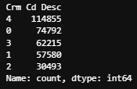
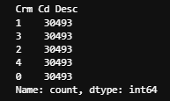
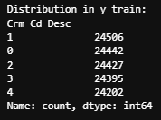
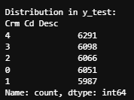
Model Training Process
2. Splitting the Datasets
Before Balance
After Balance
Balance the Data
Ensures balanced classes before creating train-test splits.
Split the dataset feature
Input(x) = Latitude, Longitude, Minute, Day ,Month, Area, Premis, Time Period, Day of Week.’
Output(y) = Crime Description
Divide data into:
Training Set (80%): For teaching the model patterns.
Testing Set (20%): For evaluating model performance on unseen data.
80% Training Set
20% Test Set
Notes:
Moving on the dataset splitting, we balanced the data to avoid bias during model training due to data skewness. Then we split the data into 80 % training and 20 % testing set.

Slide 24
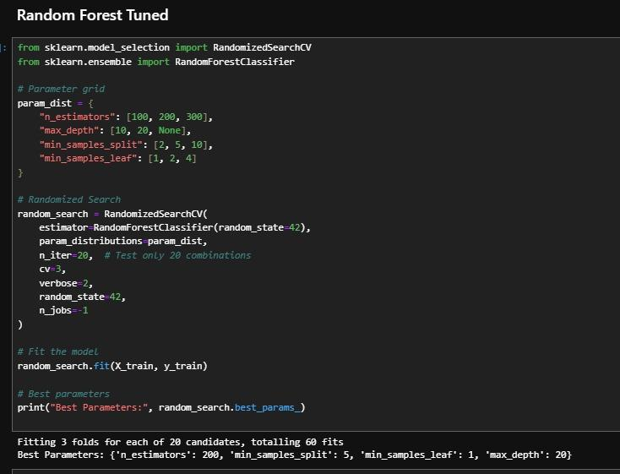
Model Training Process
3. Hyperparameter Tuning: Randomized Search
Pros
Efficient
Saves computational resources
Random sampled combinations
Suitable for large complex datasets
Cons
May miss optimal combination
Dependent on number of iterations
Notes:
Then, we did hyperparameter tuning. For this project, we chose randomized search because it is efficient due to the fact that it does not test every combination, allowing it to save computational resources, and is suitable for large complex datasets. However, the tradeoff was that it may miss out on optimal combinations.

Slide 25
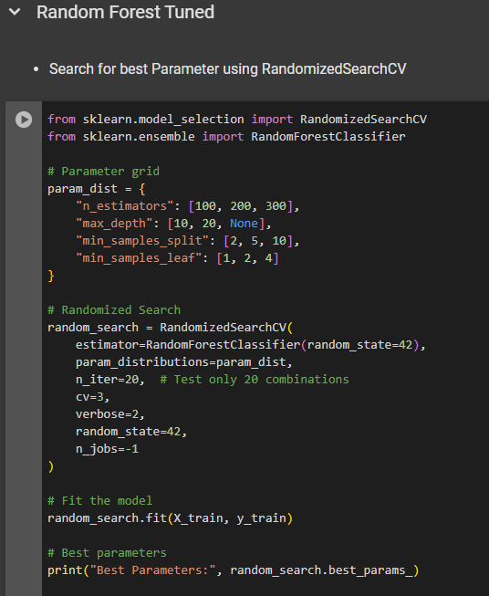
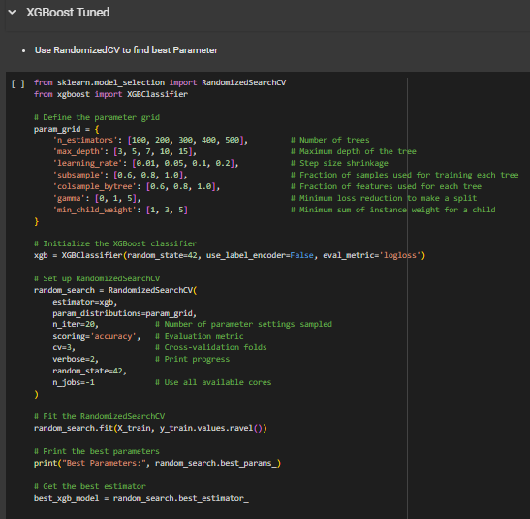
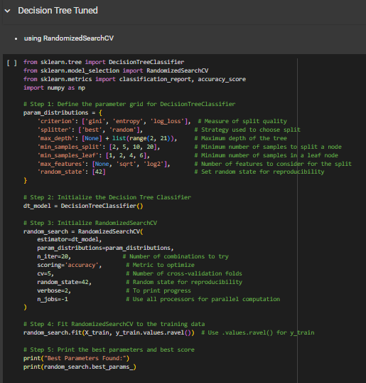
Model Training Process
3. Hyperparameter Tuning: Randomized Search
Notes:
Here are the models that we have done hyperparameter tuning, as a result,
Random forest 72.05 - > 72.67 %
Xgboost 74.19 -> 74.23
Decision Tree 67.95 ->71.60 %

Slide 26
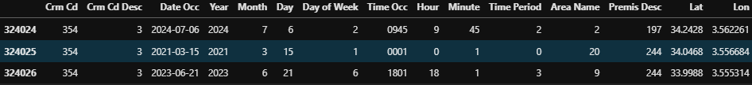
Models to Use
01
Classification for Crime Type Prediction
Goal : To Predict the type of crime happen based on location and time.
This will support resource allocation and crime prevention effort for policeman.
Input Features : Latitude, Longitude, Hour, Minute, Day, Month, Area Name, Premis Description , Time Period, Day of Week.
Type of Model Use :
Random Forest : An ensemble technique that combines multiple decision trees to improve performance
Gradient Boosting (XGBoost) : Combines weak models to create one strong predictive model
Decision Tree: Versatile and simple
K-Nearest Neighbour : simple to implement, sensitive to the scale of features
Naive Bayes : highly scalable, works on large datasets
Ada Boost : An ensemble technique that combines multiple decision trees to improve performance
Notes:
Which brings us to the models used. For classification, we wanted to predict the type of crime occurrence based on location and time, we used randomforest, gradient boosting, decision tree, KNN, naive bayes and ada boost, which the input features as shown in the slides, such as latitude, longitude, time and premis description. We have also included some benefits of the models for your reference. For example, Random Forest and Ada boost are both ensemble techniques that combie multiple decision trees to improve the performance of the predictive model.

Slide 27
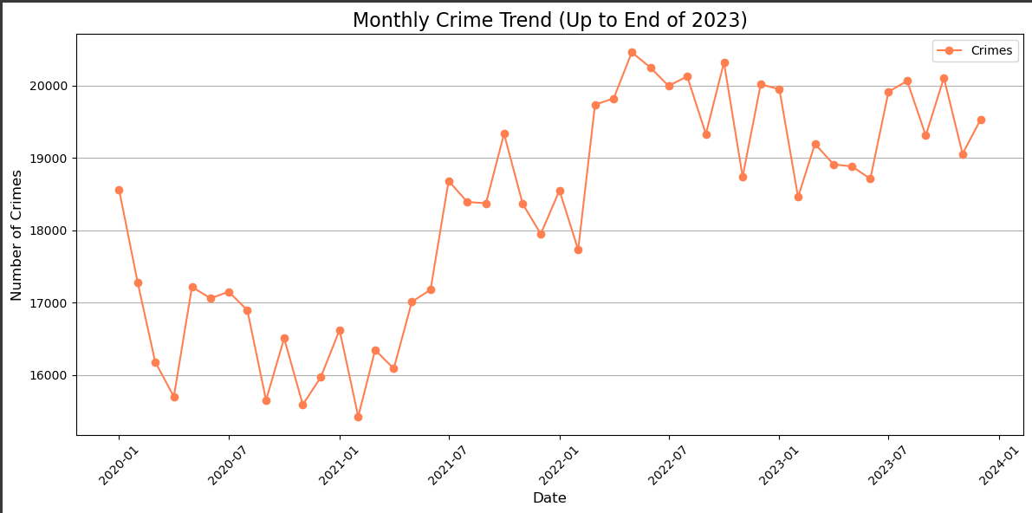
Models to Use
02
Time-series Forecasting: Holt-Winters Forecasting
Goal : To predict future crime for 2020 to current times (end of 2023)
Input Features : Date Occ, Crimes
Incorporates trend, seasonality and levels
Suitable for data with strong seasonal patterns and trends
Notes:
Next, we also wanted to predict future crime from 2020 up to the end of 2023. We did the Holt-Winters Forecasting as it incorporates trends, seasonality and levels. This is especially useful for our data which has strong seasonal patterns and trends. Our input features are date of occurrence and total crimes committed. The figure above shows the forecasted results.

Slide 28
Evaluation

Slide 29
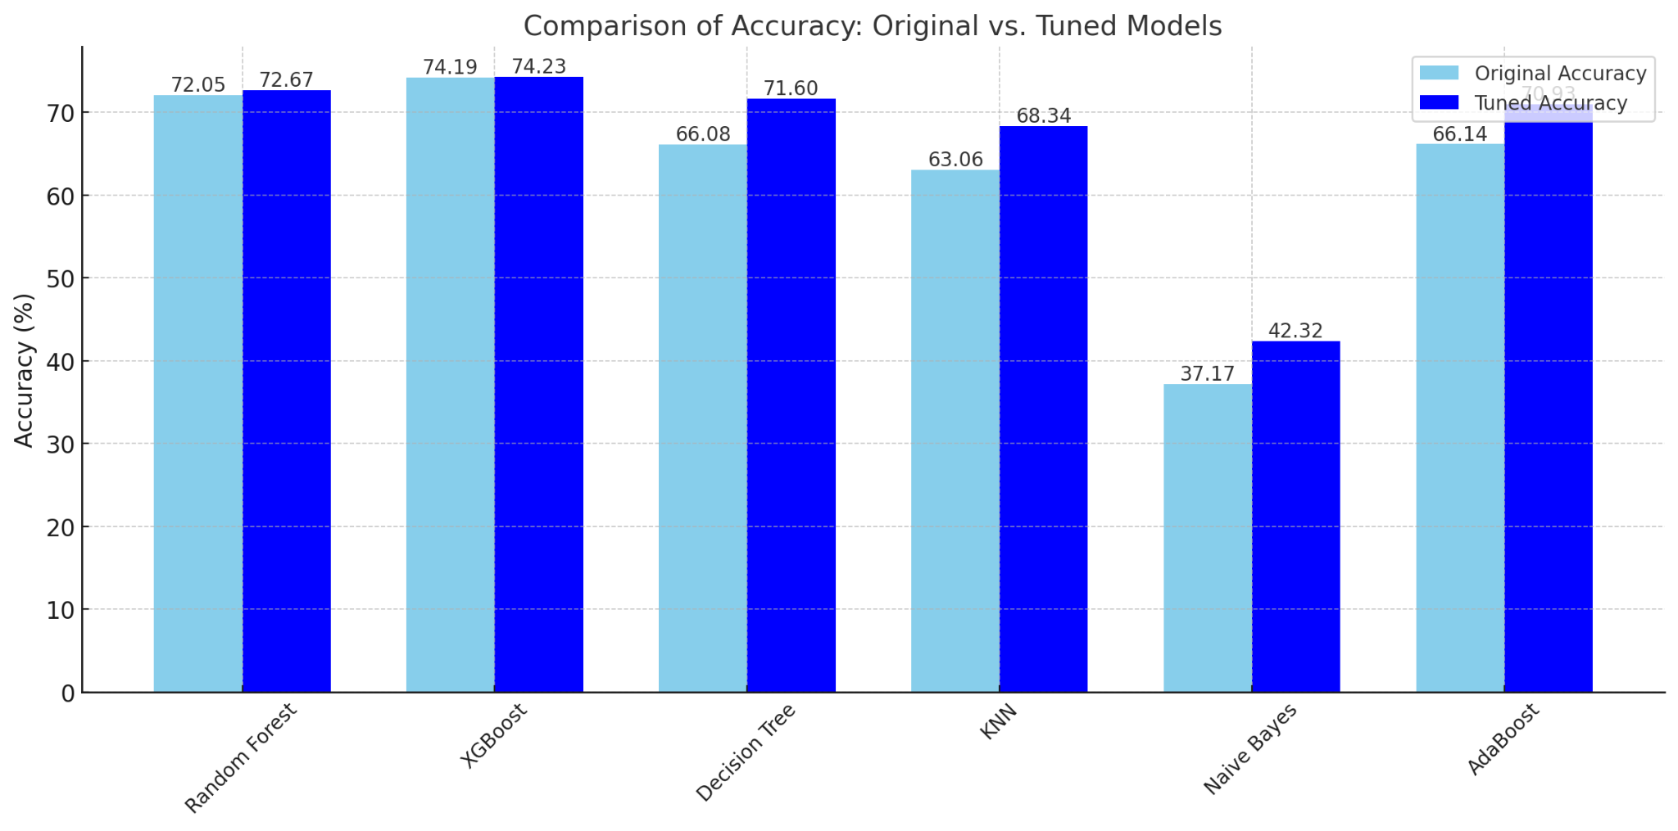
Classification Models - Comparing Original and Tuned Models
Notes:
Boek do kim

Slide 30
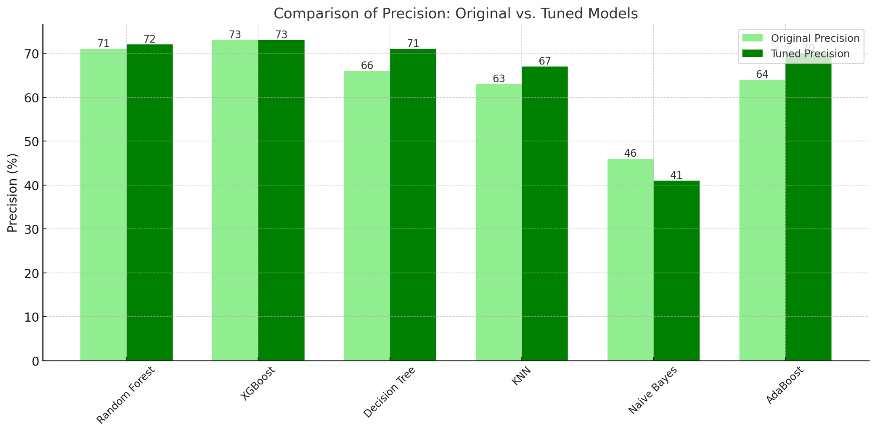
Classification Models - Comparing Original and Tuned Models

Slide 31
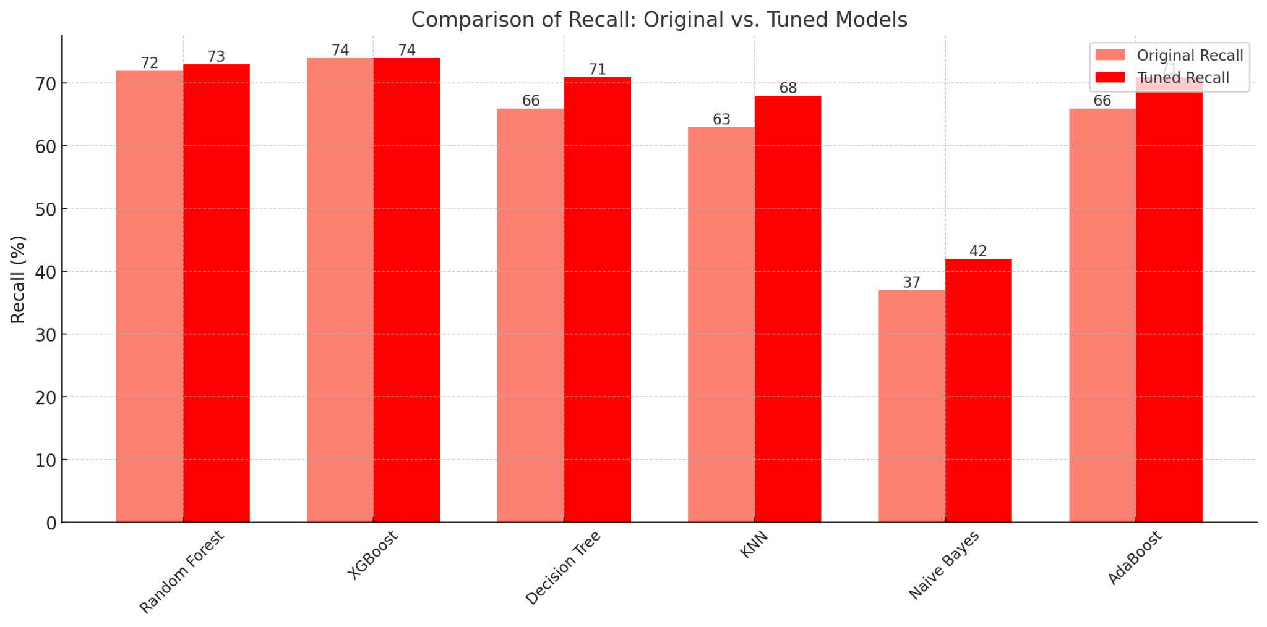
Classification Models - Comparing Original and Tuned Models

Slide 32
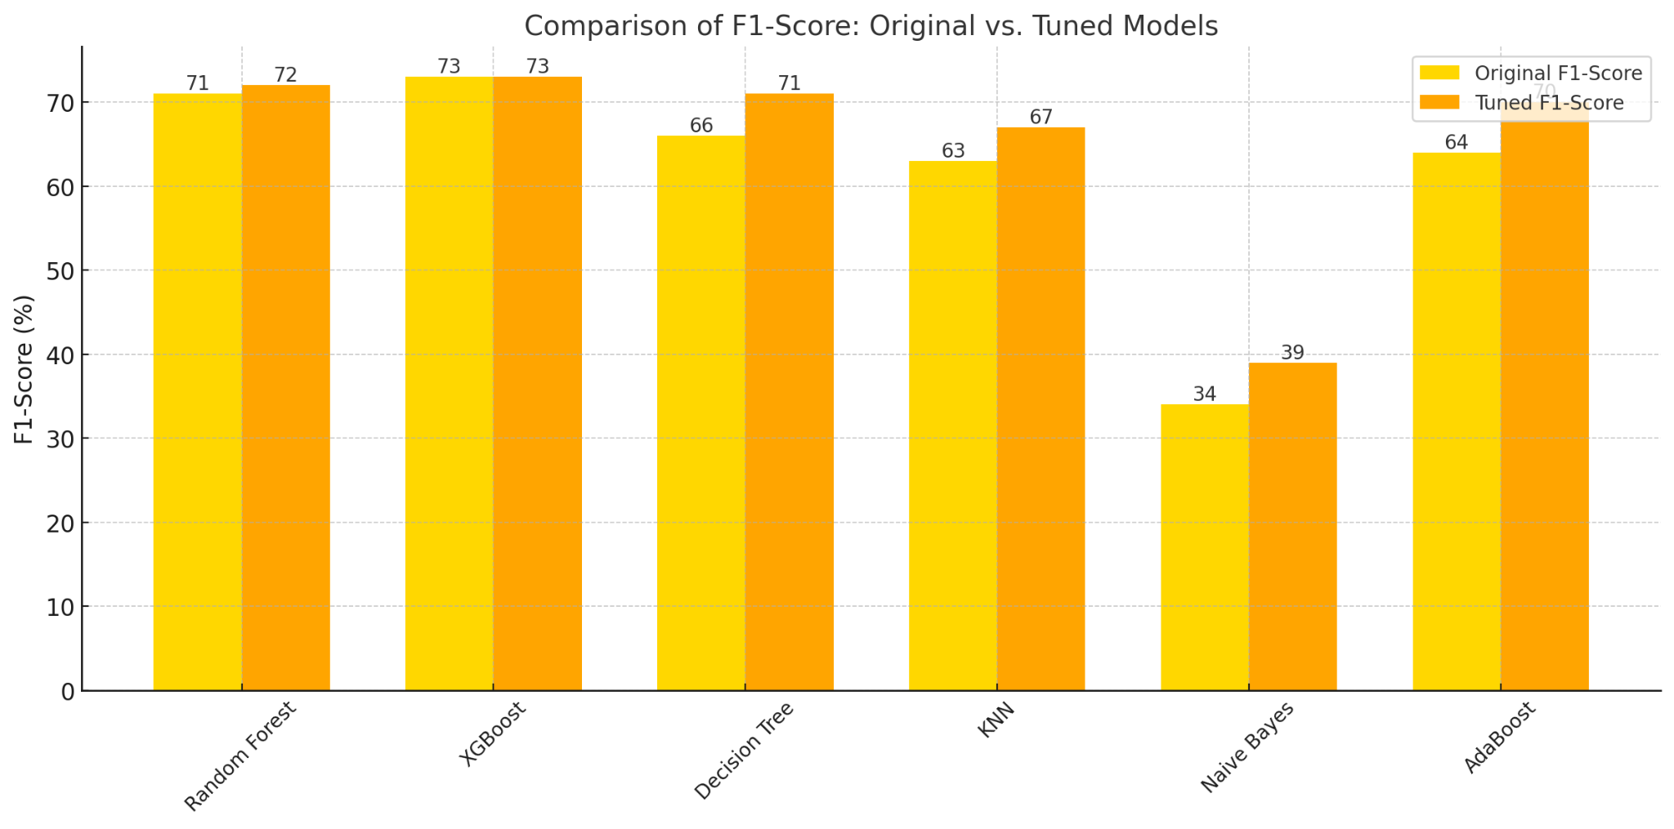
Classification Models - Comparing Original and Tuned Models

Slide 33
Key Insights Classification Models
XGBoost remains the best-performing model, consistently leading in all metrics after tuning.
Random Forest closely follows as a strong alternative, offering robust and balanced performance.
Decision Tree benefited the most from tuning, achieving notable improvements across all metrics.
Naive Bayes, despite tuning, is unsuitable for this dataset due to its inability to handle imbalanced classes effectively.
Tuning improved both ensemble and non-ensemble models, with XGBoost, Random Forest, and Decision Tree emerging as the most reliable choices.

Slide 34
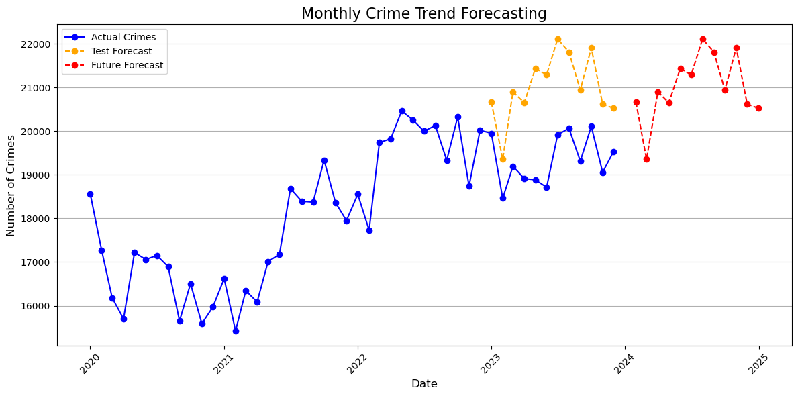
Time-Series Forecasting Model - Overview
Evaluation Metrics | Value
Mean Absolute Error (MAE) | 1673.52 crime
Mean Squared Error (MSE) | 3,124,829.16 crimes²
Root Mean Squared Error (RMSE) | 1767.72 crimes
Mean Absolute Percentage Error (MAPE) | 8.67%
RMSE as a Percentage of Average Crimes:
RMSE expressed as a percentage of the average monthly crimes (19,341.83).
Percentage: 9.14%.
Indicates that forecast deviations are around 9.14% of the typical monthly crime count.

Slide 35
Future Improvement

Slide 36
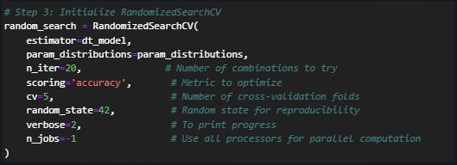
Improvements that could be made to the models
Hyperparameter Tuning
Limitations of Randomized Search include:
Computationally intensive even for the less resource intensive option of the hyperparameter selection code (Randomized Search instead of Grid Search)
Some future improvements include:
Subset Sampling
Parallel Processing
Early Stopping
Notes:
Initially, we opt to perform both types of hyperparameter searching which are Randomized Search and Grid Search. However, due to the computational intensive nature of Grid Search which evaluates all combinations by systematically exploring all spaces to select the optimal set of hyperparameters, we chose to perform Randomized Search instead. Even so, there is the limitation of performing up to certain amount of iterations (only 20 iterations shown by the image) as further increase in iterations actually crashes our devices. Therefore, here are some future improvements could be made to Randomized Search which include subset sampling: conduct hyperparameter tuning on a smaller subset prior to retraining model on full dataset, parallel processing: include parallelism arguments in
Randomized Search to fully utilise CPU cores to reduce execution time and implementation of early stopping to terminate unpromising hyperparameter evaluation processes to save up computational resources.

Slide 37
Improvements that could be made to the models
2. Issue with Coordinates
Coordinates for crime location in terms of latitude and longitude are not always considered as one parameter entity due to potential splitting of coordinates into 2 separate features (either latitude or longitude only)
Resolution
Resolution could be achieved through combining both latitude and longitude into one parameter entity.
Example
By using relative spatial position:
1. Choose a reference point
2. Distance calculation.
3. Replace coordinates with
calculated distance
Meaningful reference point like central location etc.
Different types of formula used like Haversine formula Euclidean distance depending on needs.
Calculated distance added as new feature that can represent coordinates as one single parameter.
Notes:
Furthermore, there is also the issue with including latitude and longitude as parameters for the model as both latitude and longitude are sometimes considered as two separate parameters instead of one single parameter entity which could introduce errors into the model. As future improvement to our machine learning model, combination of latitude and longitude into one single parameter entity can be done using the concept of relative spatial position. This involves choosing a meaningful reference point like some sort of central location among all crime locations, calculating the distance between crime location and reference point using formulas like Haversine formula (for spherical distances) or Euclidean distance (if area is small and curvature can be ignored), then replacing the coordinates with the calculated distance and introduce it as a new feature to the model as one single parameter.

Slide 38
Deployment

Slide 39
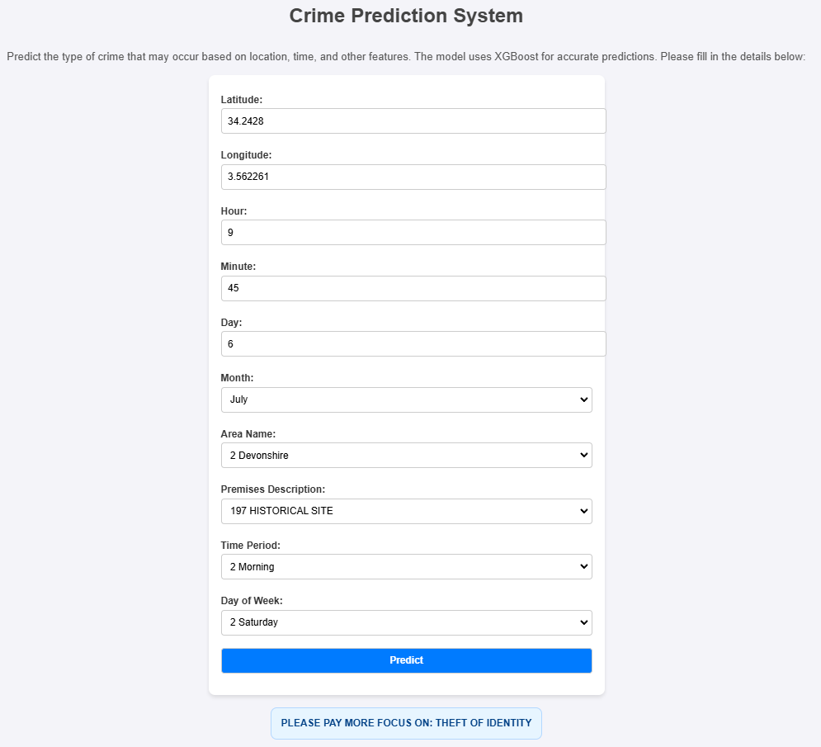

Deployment
Deployment : Using Flask
Highest Accuracy Model is Used which is XGBoost
The model are save as .pkl file and are Load to the flask application.
Html template are created for user interaction.
Flask App allows us to handle HTTP request to process user input and return results.
FrontEnd
(Html)
Input
Input
ML Model
(XGboost)
output
output

Slide 40
Thank You!
Does Anyone Have any Question ?

Slide 41
Steps in Evaluation
Reference:
True Positives (TP): Correctly predicted thefts.
True Negatives (TN): Correctly predicted non-thefts.
False Positives (FP): Non-thefts incorrectly predicted as thefts.
False Negatives (FN): Thefts incorrectly predicted as non-thefts.
Evaluating Classification Models
01
Accuracy
Measures the proportion of correct predictions out of all predictions
Accuracy = Total Predictions / Correct Predictions​
02
Precision
Focuses on the quality of “theft” predictions.
Precision = True Positives / (True Positives + False Positives​)
03
Recall
Measures the model’s ability to identify all actual thefts.
Recall = True Positives / (True Positives + False Negatives)
04
F1-Score
Balances precision and recall. It’s the harmonic mean of the two.
F1 = 2 x ((Precision x Recall) / (Precision + Recall))
05
ROC-AUC
Measures the model's ability to distinguish between theft and non-theft.

Slide 42
Models to Use
01
K-Means Clustering: Groups crimes by geographic and temporal similarity to identify hotspots.
DBSCAN: Groups crimes based on density, useful for finding densely clustered crime areas (hotspots)
Clustering for Crime Patterns
Logistic Regression: Baseline model for understanding factors contributing to theft.
Random Forest: Identifies complex relationships and ranks importance (e.g., time, area).
Gradient Boosting (XGBoost): Fine-tunes predictions for higher accuracy in theft likelihood.
Decision Tree
K-Nearest Neighbour
Naive Bayes
Ada Boost
02
Classification for Crime Type Prediction

Slide 43
Models to Use
01
K-Means Clustering: Groups crimes by geographic and temporal similarity to identify hotspots.
DBSCAN: Groups crimes based on density, useful for finding densely clustered crime areas (hotspots)
Clustering for Crime Patterns
02
Logistic Regression: Baseline model for understanding factors contributing to theft.
Random Forest: Identifies complex relationships and ranks importance (e.g., time, area).
Gradient Boosting (XGBoost): Fine-tunes predictions for higher accuracy in theft likelihood.
Classification for Vehicle Theft Prediction
03
Use feature importance analysis from the models above to identify significant contributors.
Temporal and Social Factors

Slide 44
Deployment Workflow
Pre-Deployment Preparation
05
Post-Deployment Monitoring
01
04
Deployment to Production
Developer User Tools
02
03
Testing and Validation

Slide 45



Objective of Evaluation
To assess whether the models are:
Accurate and reliable.
Provide actionable insights for law enforcement.
Robust enough to generalize to new data.

Slide 46
Questions
01
02
03
What emerging technologies or techniques could enhance predictive modeling for crime prevention?
What are the risks and benefits of fully automating certain aspects of crime prediction and prevention?
How might integrating social media or public sentiment data improve crime predictive models?

Slide 47
Steps in Evaluation
Evaluating Clustering Models
Silhouette Score
Inertia
Practical Validation
Measures how similar crimes within the same cluster are, compared to crimes in different clusters.
Higher scores indicate well-separated clusters.
Compare identified hotspots with known high-crime areas.
For example, are the the identified hotspots aligned with area that law enforcement already suspects?
Measures the tightness of clusters.
Lower inertia means better clustering.

Slide 48
Steps in Evaluation
Reference:
True Positives (TP): Correctly predicted thefts.
True Negatives (TN): Correctly predicted non-thefts.
False Positives (FP): Non-thefts incorrectly predicted as thefts.
False Negatives (FN): Thefts incorrectly predicted as non-thefts.
Evaluating Classification Models
01
Accuracy
Measures the proportion of correct predictions out of all predictions
Accuracy = Total Predictions / Correct Predictions​
02
Precision
Focuses on the quality of “theft” predictions.
Precision = True Positives / (True Positives + False Positives​)
03
Recall
Measures the model’s ability to identify all actual thefts.
Recall = True Positives / (True Positives + False Negatives)
04
F1-Score
Balances precision and recall. It’s the harmonic mean of the two.
F1 = 2 x ((Precision x Recall) / (Precision + Recall))
05
ROC-AUC
Measures the model's ability to distinguish between theft and non-theft.

Slide 49



Select Data
Select
Selection of the overall crime types available based on crime occurrences, time, location and gender as initial exploration analysis.
Data, attributes and records used for analysis
Criteria includes data mining goals, data quality, technical constraints and so on.
Focus
Focusing on vehicle-related crimes due to it having the most frequent occurrences as well as in regards to the technical constraints of processing the whole dataset.
Details
Crime codes associated : 520 = Vehicle - Attempt Stolen
510 = Vehicle - Stolen
Notes:
Concerns with the data that we use for our analysis as well as attributes and records for the table. The criteria for selection of data can include data mining goals, quality of data, technical constraints and so on. Initially select the overall crime types based on crime occurrences, time, location and gender to explore the dataset
Decision to focus on vehicle-related crimes due to being the most frequent occurrence and technical constraints to process the whole dataset (long run time)
The crime codes associated with the vehicle-related crimes are as follows:
520 = Vehicle - Attempt Stolen
510 = Vehicle - Stolen

Slide 50




Formulate Data
Convert raw date format into one standard form in order to standardize the date format to ensure data consistency across the dataset.
Eg. Standardizing date format into year, month, day for data consistency
Notes:
Formatting data refers to modification of syntax of the data according to the data modelling tool used without changing its meaning.

Slide 51

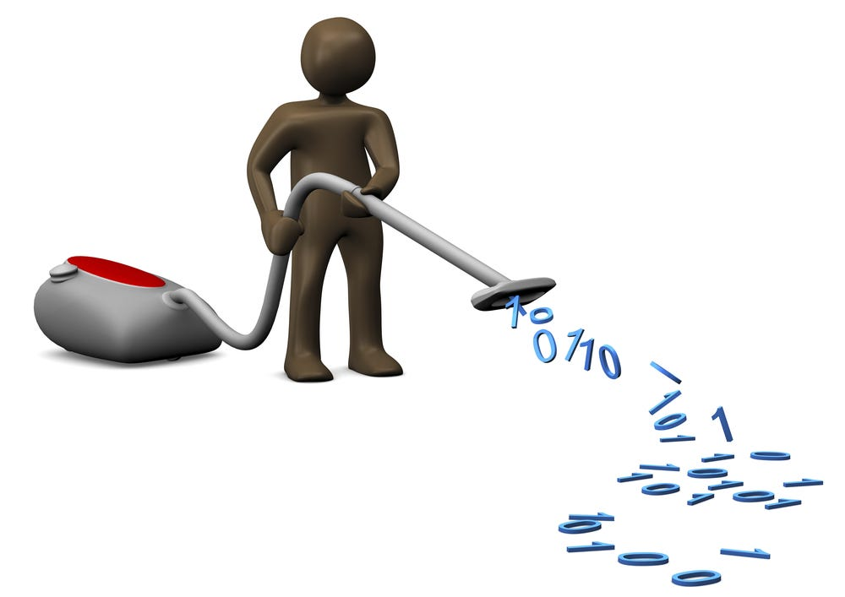
Clean Data
Incomplete Values
Outliers
Identification of outliers using the formula below:
IQR (Interquartile range) = Q3 (Third quantile) - Q1 (First quantile)
Upper boundary = Q3 + 1.5 IQR
Lower boundary = Q1 - 1.5 IQR
Outliers identified and removed if observation data does not fall within upper and lower boundary.
Selection of cleaner subset
Deletion of rows with missing data (small portion)
Impute missing values with the most suitable defaults
Notes:
The main goal of data cleaning is to increase the quality of the data used for analysis.
Handling Incomplete Data (Missing Values):
Selection of cleaner subset of the overall data
Deletion of rows with missing data if comprise only small portion
Filling in missing values with the most suitable defaults as determined by the various imputation methods
Handling Outliers
Identify and address outliers in the data set that could potentially cause skewness of results using the formula below:
IQR (Interquartile range) = Q3 (Third quantile) - Q1 (First quantile)
Upper boundary = Q3 + 1.5 IQR
Lower boundary = Q1 - 1.5 IQR
If observation data does not fall within the range of lower boundary and upper boundary, then it is an outlier which will be removed.

Slide 52




Construct Data
Raw timestamps into time-of-day groups: Early Morning, Morning, Noon, Evening and Night.
Eg. Time 2100 falls under Night category
Categorisation
Crime types into broader groups such as Crimes related to motor vehicles, boat & bike fall under “Vehicle Theft - Attempt” and “Vehicle Theft - Stolen”.
Raw date data into days-of-the-week groups such as Monday, Tuesday and so on.
Notes:
Construction of data involves production of derived attributes, records that are entirely new or values that are transformed from existing attributes.
Categorizing raw timestamps into time-of-day groups such as Early Morning, Morning, Noon, Evening and Night.
Eg. Time 2100 falls under Night category where as 0500 falls under Early Morning category
Categorizing raw date data into days-of-the-week groups such as Monday, Tuesday, Wednesday and so on.
Categorizing crime types into broader groups such as various vehicle-related crimes (Motor vehicles, boat, bike etc) under “Vehicle Theft - Attempt” and “Vehicle Theft - Stolen”.

Slide 53
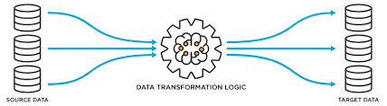
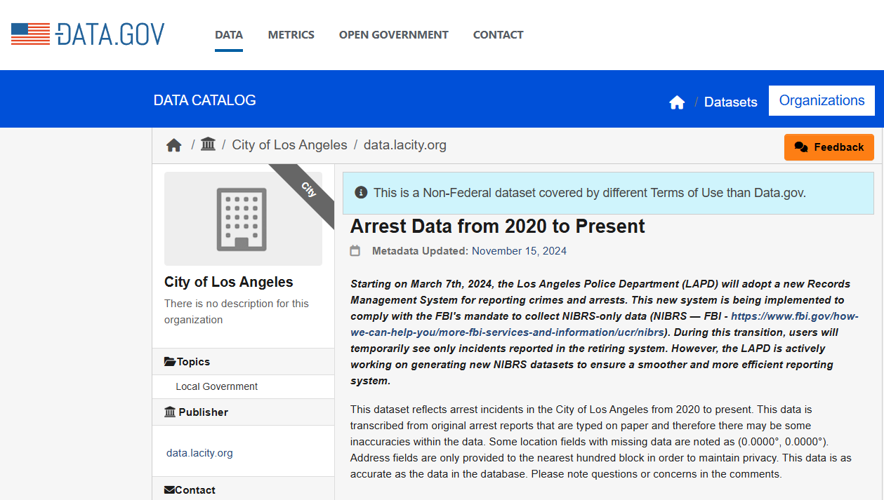
Integrate Data
Combination of LAPD Crime_Data_From_2020_to_Present with LAPD Arrest_Data_From_2020_to_Present to create a new dataset for analysis.
Integration can be done using foreign key-primary key relationship between both datasets.
Eg. Both shared the same Area ID.
Notes:
Integration of data involves combination of multiple tables or records to generate new records or values.

Slide 54
BUSINESS UNDERSTANDING

Slide 55
Data Preparation
04
Data Integration
Combine Lapd Crime Data & Lapd Arrest Data (2020-2024) for further analysis .
Notes:
Integration of data involves combination of multiple tables or records to generate new records or values.
For our project, we opt to combine Lapd Crime Data & Lapd Arrest Data (2020-2024) for further analysis .
Integration can be done using foreign key-primary key relationship between both datasets.
Eg. Both shared the same Area ID.

Slide 56
PROBLEM STATEMENT
Crime prevention and resource optimization are critical challenges for law enforcement agencies.
This study uses the LAPD crime dataset to analyze patterns in criminal behavior, with a focus on vehicle theft, to understand factors driving high crime rates.
By exploring hotspots, temporal trends, and underlying influences, the goal is to generate insights that can inform data-driven strategies for targeted crime prevention and improved public safety.

Slide 57
OBJECTIVE
01
02
03
To identify the pattern of most frequent crimes and their distribution across neighborhoods in Los Angeles to detect high-crime areas.
To model a predictive model of vehicle theft crime occurrences, enabling a proactive approach for resource allocation
To evaluate potential for predictive modeling in forecasting vehicle theft based on historical patterns and influencing factors.

Slide 58
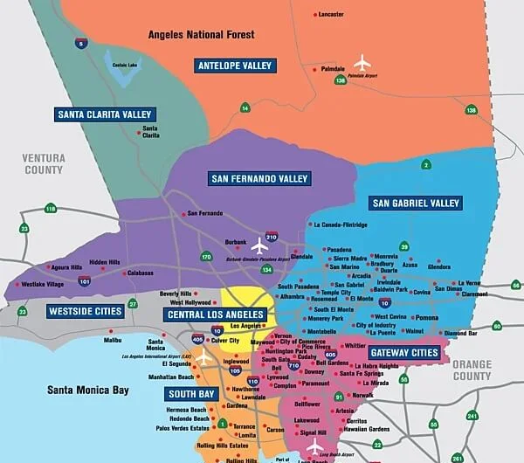
PROJECT SCOPE
Scope
The project scope is on leveraging historical crime data from the Los Angeles Police Department (LAPD) for the years 2020 to 2024 to predict future crime patterns and trends.
Notes:
This involves analyzing various attributes of crimes, such as location, time, and type, to support crime prevention initiatives and resource optimization.

Slide 59
Data Exploration : Conclusion
Notes:
We also compared the crime count to the crime location (premises description), the bar graph below shows that the locations where crimes were commonly committed were streets, followed by single family dwelling and multi-unit dwellings. Further analysis can be done to check to the location either if it was desolated or populated area.

Slide 60
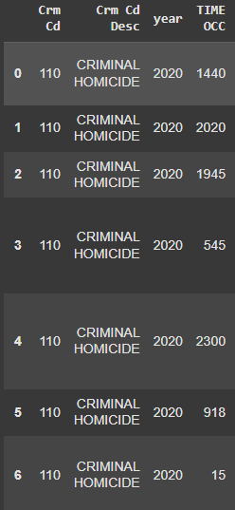
Initial Data Exploration : Time of Crime Occurrence
Data Insights :
- Date format is incorrect and should be cleaned and reformatted
Notes:
the date format is incorrect, showing the need to clean and reformat in the data processing process later.

Slide 61
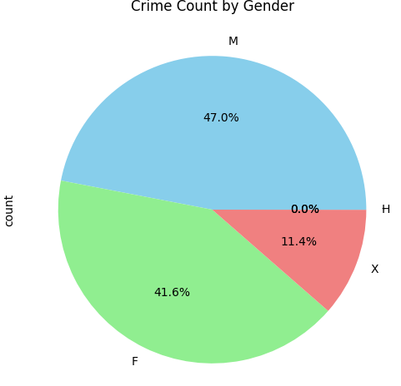
Initial Data Exploration : Crime Count by Gender
Data Insights :
Males: 47.0 %
Females: 41.6 %
Others: 11.4 %
H: 0 %
Notes:
In terms of crime committed by each gender, there is a relatively balanced distribution of 47 % males and 41.6 % females. The remaining 11.4 % is categorized under X for other genders. There is also the category ‘H’, which indicates that the data is not fully cleaned yet, further data processing is needed.

Slide 62
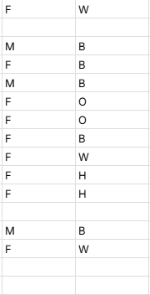
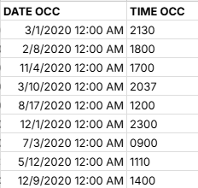
Verify Data Quality
Completeness | Some missing values detected on victim Sex and Age
Consistency and Timeliness | Invalid Date Format : Data is not correctly formatted as it also input the time on the date column. Invalid Time Format This could be corrected by Splitting the column of date and time. Time and date can be further splitted as (Day of month, Hour of day ). Certain crime type can be categorized together.
Accuracy | Some Age data is recorded as -2 ( Logical Error)
Duplication | Number of duplicate rows : 898

Slide 63
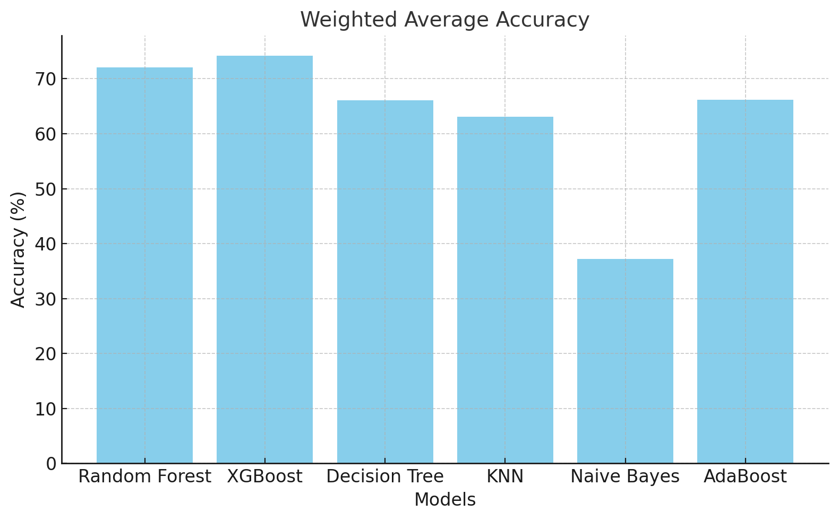
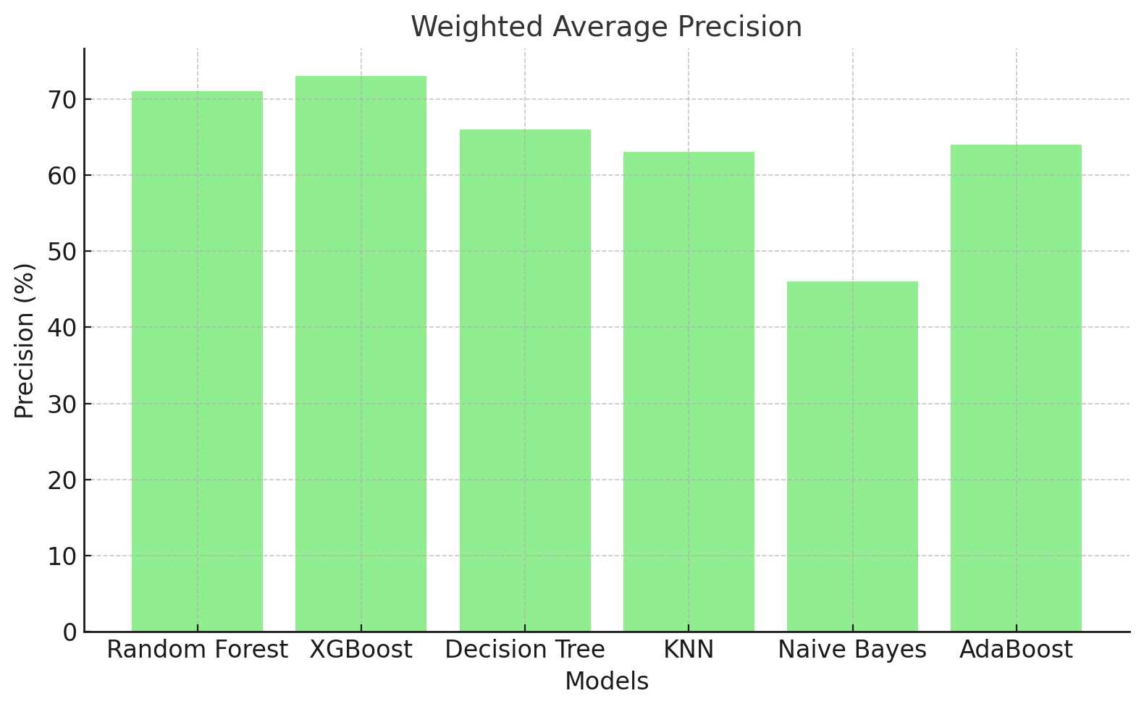
Classification Models - Comparing Original and Tuned Models
Model Performance: Accuracy
XGBoost achieved the highest accuracy (74.19%), indicating its superior overall prediction capability.
Random Forest followed closely with an accuracy of 72.05%.
Naive Bayes had the lowest accuracy (37.17%), reflecting its limitations for this dataset.
Model Performance: Precision
XGBoost and Random Forest maintained the highest precision at 73% and 71%, respectively, showcasing their ability to minimize false positives.
KNN and Naive Bayes struggled with lower precision, with Naive Bayes at just 46%.

Slide 64
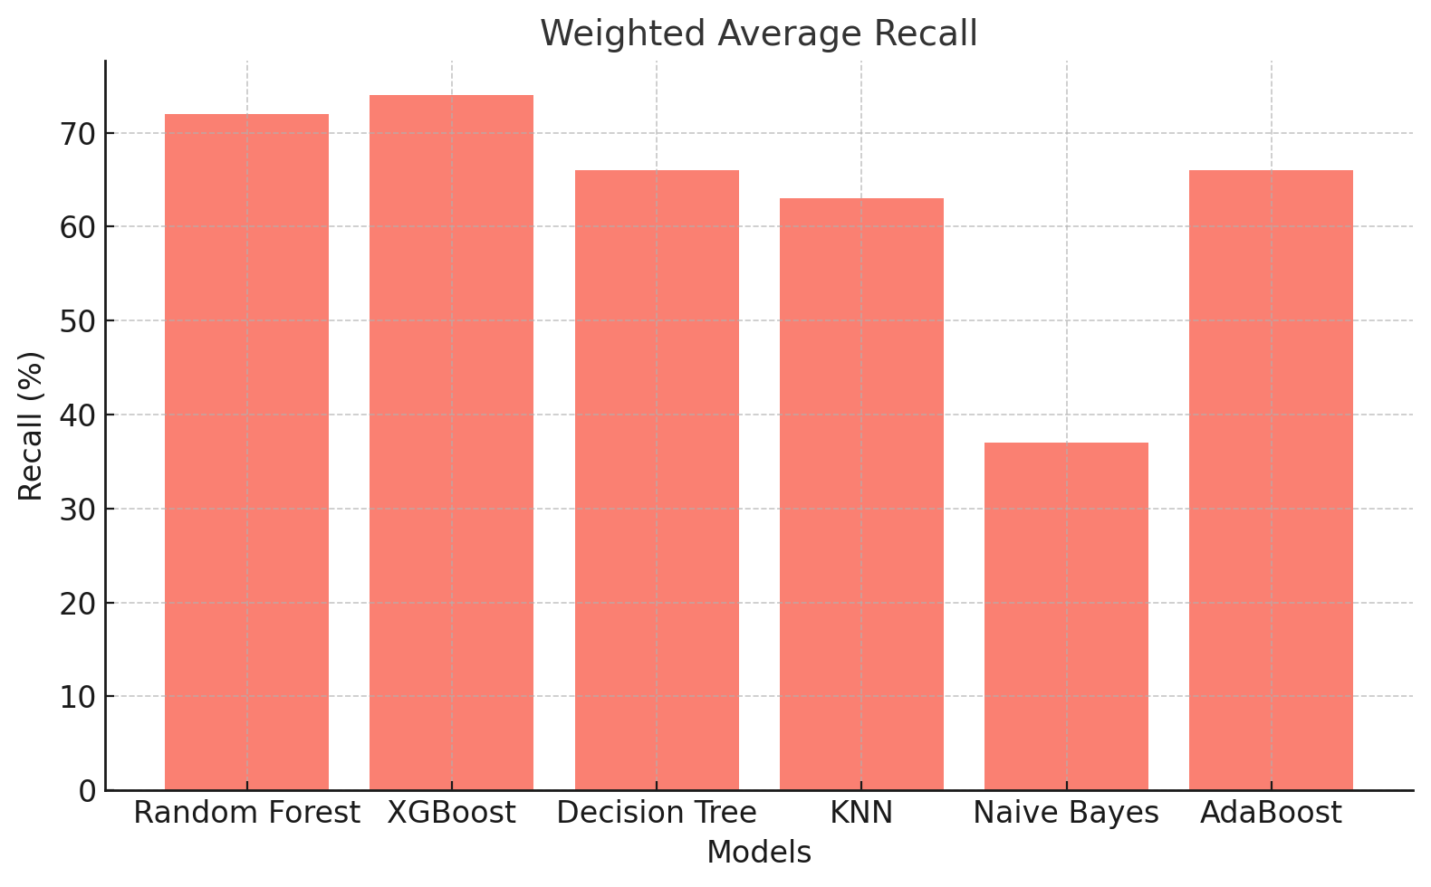
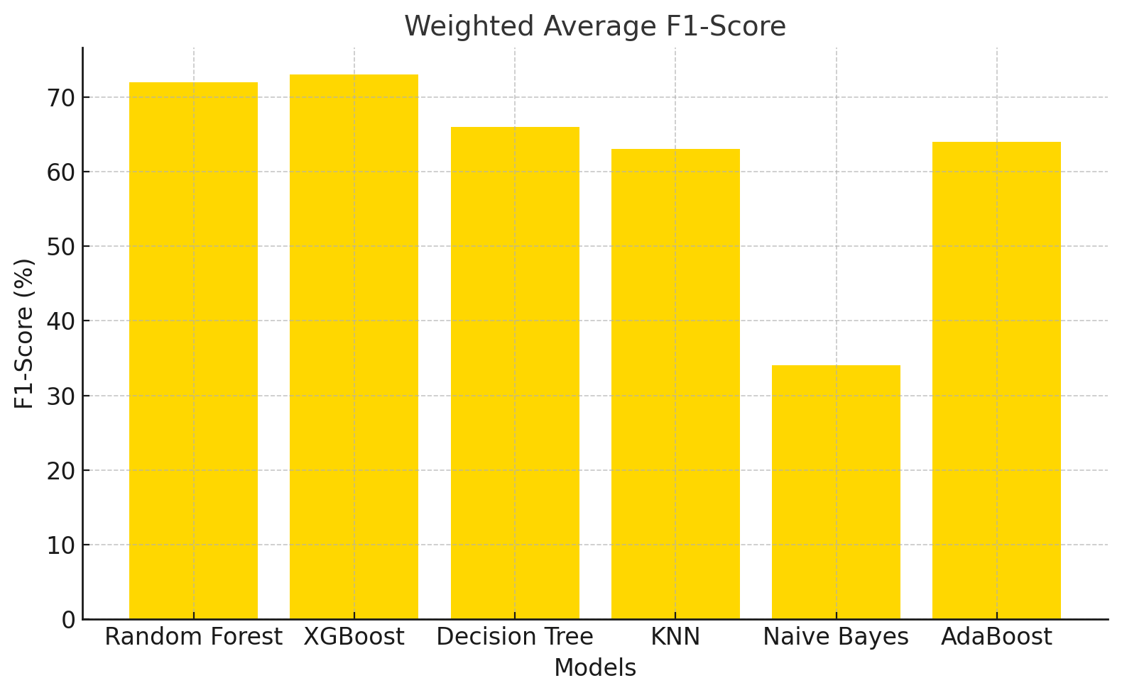
Classification Models - Comparing Original and Tuned Models
Model Performance: Recall
Recall was highest for XGBoost (74%) and Random Forest (72%), highlighting their effectiveness in capturing true positives.
Naive Bayes again performed the worst, with a recall of only 37%, indicating difficulty in identifying relevant cases.
Model Performance: F1-Score
XGBoost and Random Forest excelled with F1-scores of 73% and 72%, reflecting a strong balance between precision and recall.
Naive Bayes lagged significantly with an F1-score of 34%, confirming its poor balance in predictive performance.

